Slide 1

Online Course Management System

Slide 2
Jawaharlal Nehru New College of Engineering
Guided By:
Mr. Sathyanarayana S _{BE, M.Sc(IT), M.Tech}
Assistant Prof., CS&E
Mrs. Namitha M V _{BE, M.Tech}
Assistant Prof., CS&E
Presented By:
Mr. Manjush V G 4JN19CS050
Mr. Murali venkat J 4JN19CS057
Mr. Ganesh prasad M 4JN19CS033
Mr. Mahendra S M 4JN19CS048

Slide 3
Outline
Problem statement
Objective
Front end
Backend
Functionalities
ER diagram
APIs
Future Scope
Conclusion

Slide 4
Problem Statement
Nowadays’ the world of education and learning is moving towards online. Every student may not have a good bandwidth and they may face network issues if the teaching is live. So, for those students who do not have a good bandwidth, concepts will not be clear.

Slide 5
Objectives
Main objective of Online Course management system is to provide simple, universal access to information and services for students, faculty, and universities.
Our aim is to give best service to the users who wants to get knowledge from our online platform.
Enhance the quality of learning and teaching.
Meet the learning style or needs of students.
Improve the efficiency and effectiveness.
Improve user-accessibility and time flexibility to engage learners in the learning process.

Slide 6

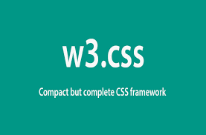
Front end languages used

Slide 7


Backend language and database used

Slide 8
Functionalities
Search
Wishlist
Enroll
Progress
Upload
Approve

Slide 9
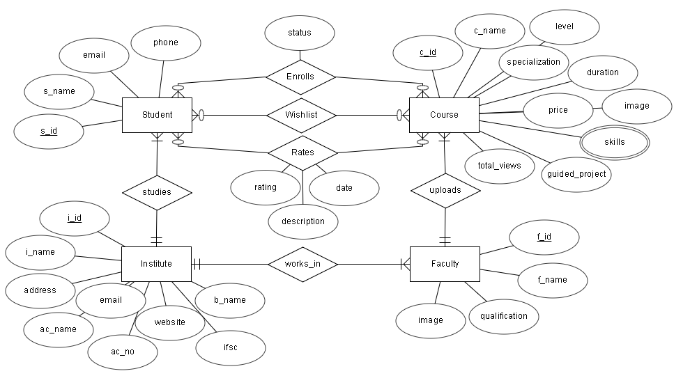
ER Diagram

Slide 10
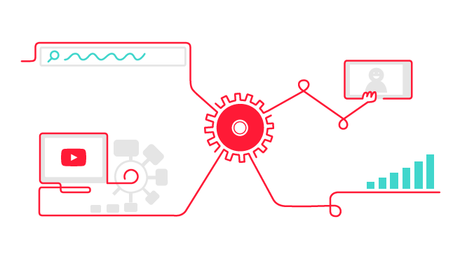
APIs used
API | Functions
YouTube Data API V3 | playlistItems().list()
 | Videos().list()
YouTube Player API | YT.Player()
 | playerObj.getDuration()
 | playerObj.getCurrentTime()

Slide 11
Future Scope
Profile editing
Course editing
Assignments for the course
Student and faculty verification
Certification

Slide 12
Conclusion
The problem in live class is that there is no guaranteed bandwidth which causes packet loss and this effects the continuity of the class. But in online learning as our project, videos are prerecorded and available at any time. Therefore, it is time flexible. Since the videos are prerecorded, if there is any packet loss then they can just go back few seconds in the video. And these courses are self-paced. Once the student is enrolled for a course then he can watch the videos any number of times.

Slide 13

Thank you

